Slide 1
Machine Learning Employee Clustering
Ong Qi Hao Tristan P2112659 DAAA/FT/2A/02

Slide 2
Content
Prediction Task
What is the modelling objective?
Background Research
Why is analysing employee resignation important?
How can clustering help the problem of employee resignation?
What are the benefits from analysing after clustering?
Exploratory Data Analysis
Univariate Analysis
Bivariate Analysis
Preprocessing and Feature Engineering
Converting datatypes
Two-sample t-Test
Analysis of variance (ANOVA)
Further Preprocessing
Feature scaling
Modelling
Comparison of different models
Model Improvement
Improvement of selected models

Slide 3
Prediction Task
Perform employee segmentation and find out what are the different characteristics of each cluster and devise a plan to retain the most vulnerable group of employees

Slide 4
Background Research
Why is analysing employee resignation important?
How can clustering help the problem of employee resignation?
What are the benefits from the analysis after clustering?
To avoid the following negative impacts:
Lowers employee morale
Low-efficiency at work
Cost of replacing an employee is high
Identify the characteristics of employees who tend to resign
Provide recommendations to the employees to keep employee retention high
Increase employee retention rates
Counter-offer these employees to avoid spending excessive costs to replace an employee who resigns

Slide 5
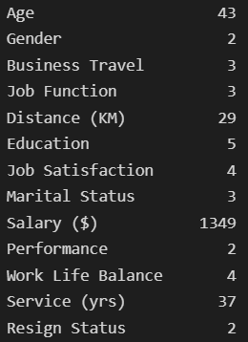
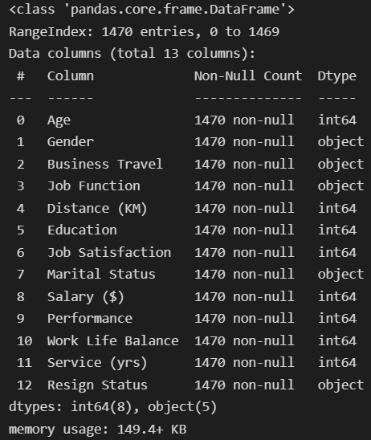
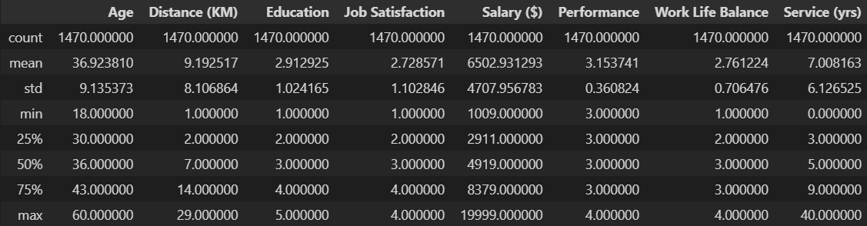
EDA (Univariate)
No. of unique values
Dataframe info
1470 rows, 13 columns
No null values in the dataset
Categorical features do not have large amount of unique values
Maximum values for Salary ($) and Service (yrs) are well above the 75th percentile, indicating outliers
Dataframe numerical summary
Columns were renamed for easier readability and interpretability

Slide 6
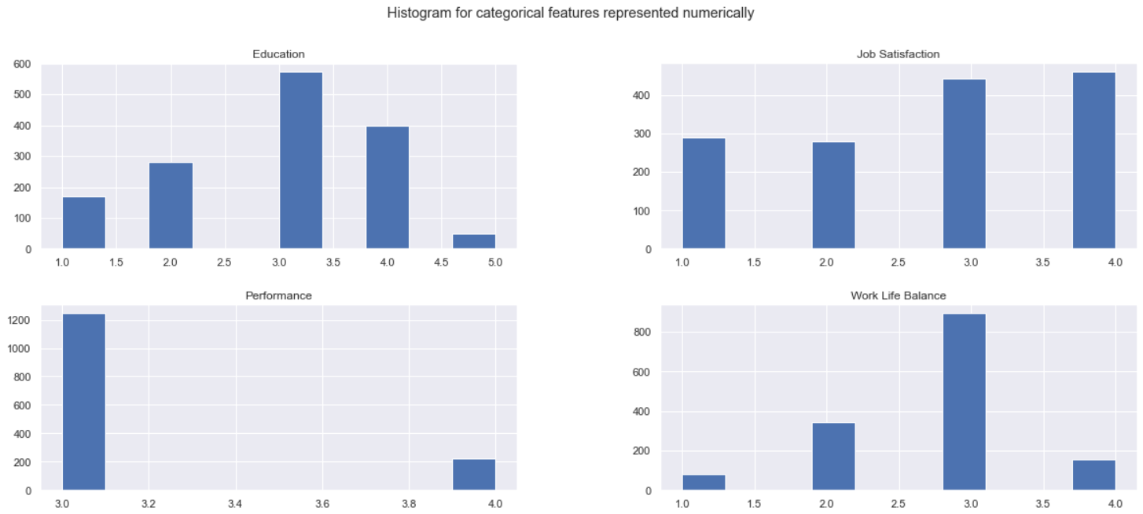
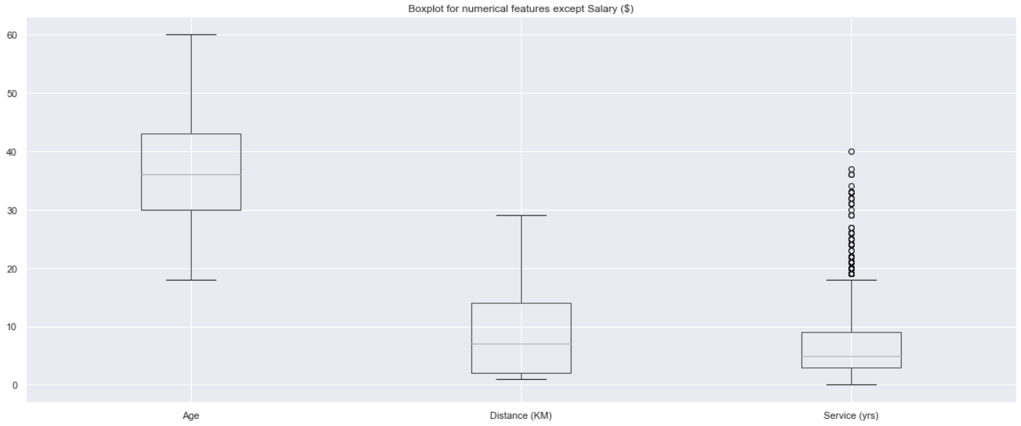
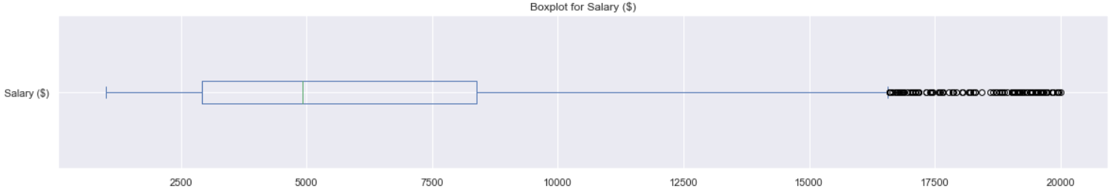
EDA (Univariate)
Age and Distance (KM) do not have any outliers
Service (yrs) and Salary ($) indeed do have outliers
Outliers indicate that the data under Service (yrs) and Salary ($) are positively-skewed
Most employees have an average education, job performance and job satisfaction level as the mode is 3
Most employees are satisfied with their job as the mode is 4

Slide 7
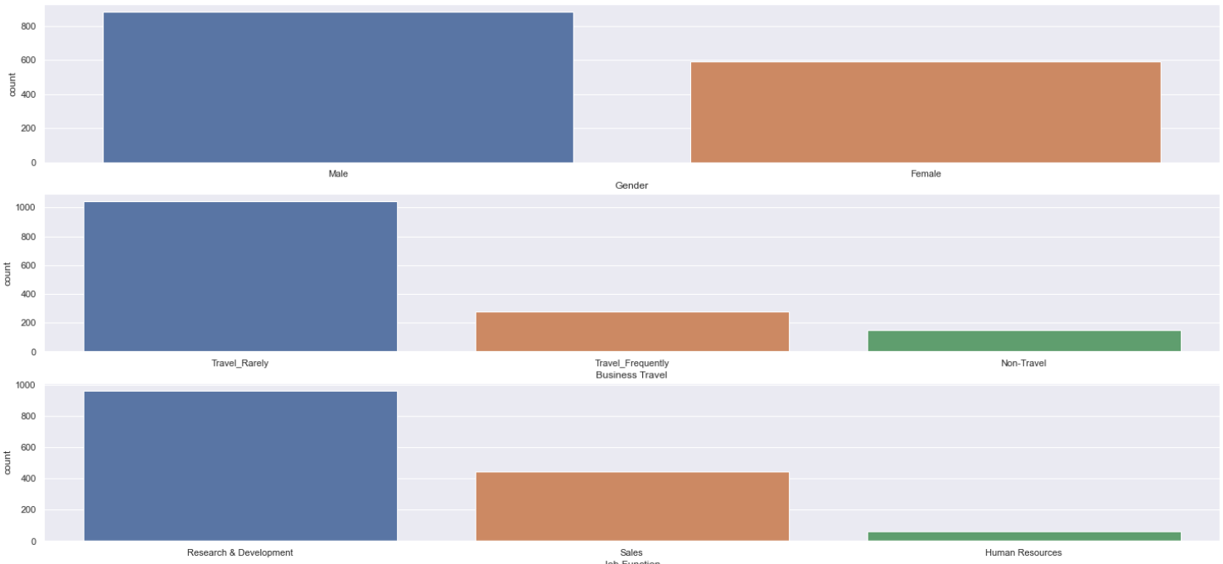
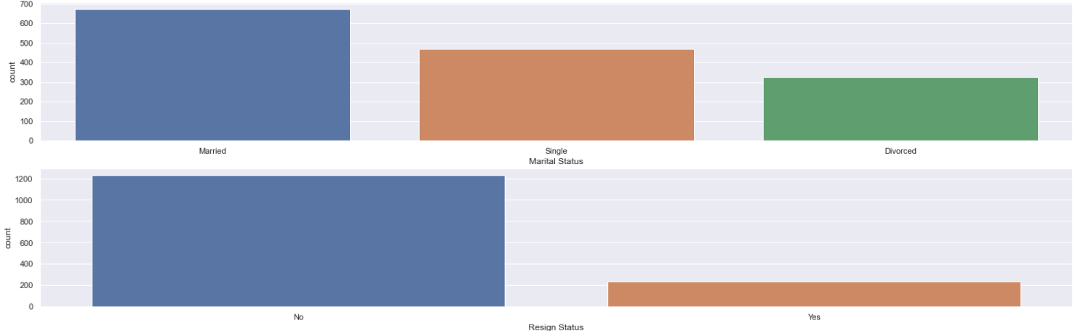
EDA (Univariate)
Most of the employees are Male with a count of 882 while there are 588 female employees
1043 employees have a job role that requires them to travel rarely while the minority have to travel frequently or do not have to travel at all
The Research & Development is the largest department with 961 employees in that department while there are only 446 employees in Sales and 63 in Human Resources
Most of the employees are married/ have been married while 470 employees are single
Out of all the employees, 237 employees have resigned denoted by the value of ‘Yes' under Resignation Status and 1233 employees are still with the company denoted by the value of ‘No'

Slide 8
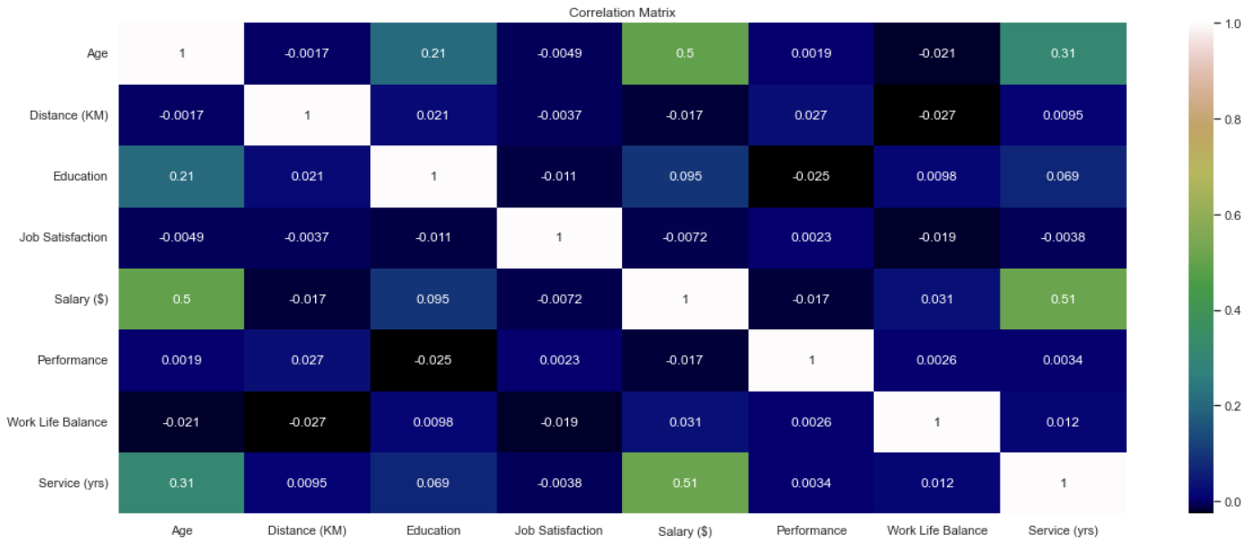
EDA (Bivariate)
Some noticeable correlations are:
Age and Service (yrs) with a correlation of 0.31
Age and Salary ($) with a correlation of 0.5
Service (yrs) and Salary ($) with a correlation of 0.51

Slide 9
Preprocessing & Feature Engineering
01
Preprocessing
02
Two-sample t-Test
03
Analysis of variance (ANOVA)
04
Remaining Features
Converting categorical features that are still in numeric form
Test for difference in population mean of two classes
Test for difference in population mean of three or more classes
Age, Job Function, Distance, Education, Marital Status, Salary, Service and Resign Status

Slide 10
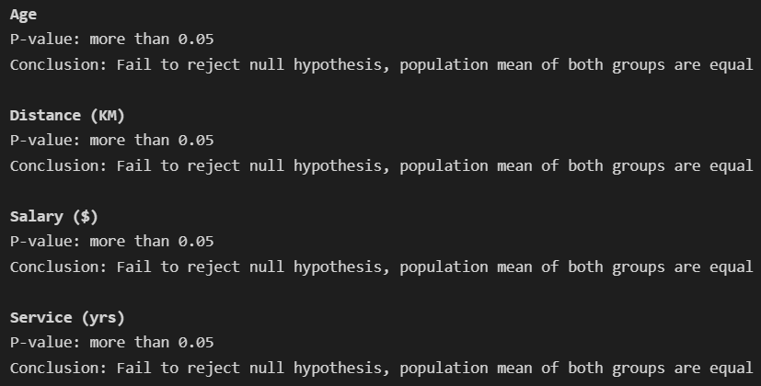
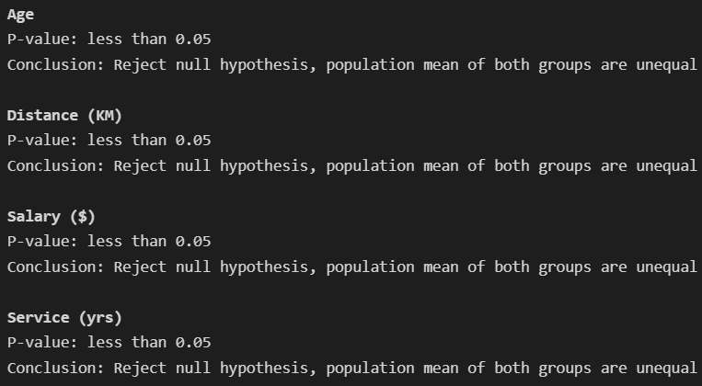
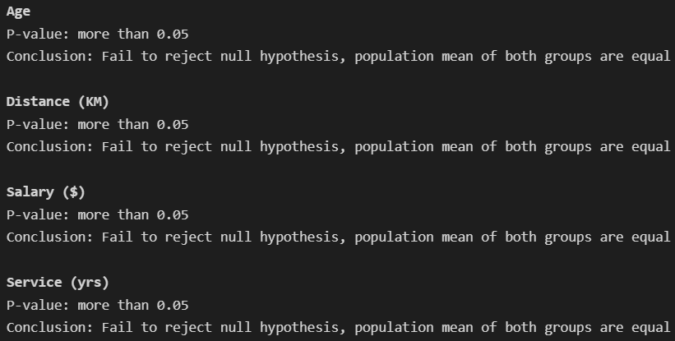
Gender (remove)
Two-sample t-Test
Resign status (keep)
Performance (remove)

Slide 11
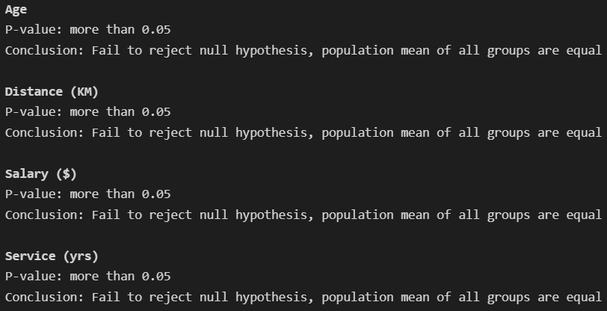
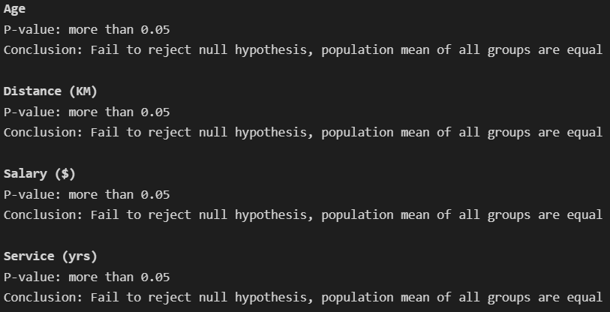
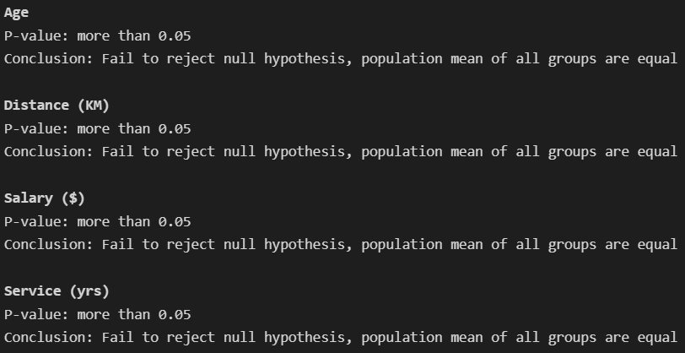
Job Satisfaction
ANOVA (Features to remove)
Business Travel
Work Life Balance

Slide 12
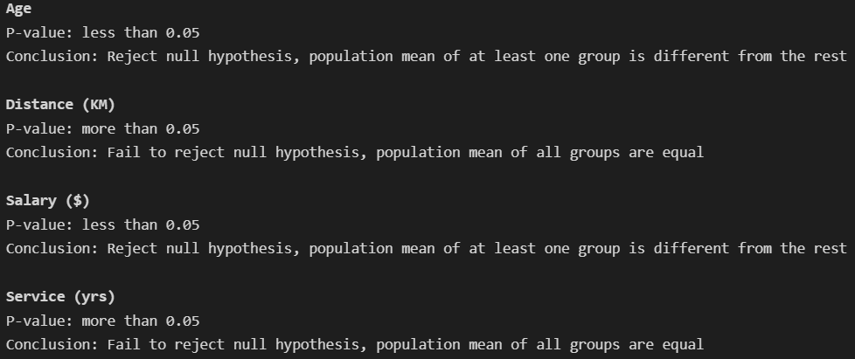
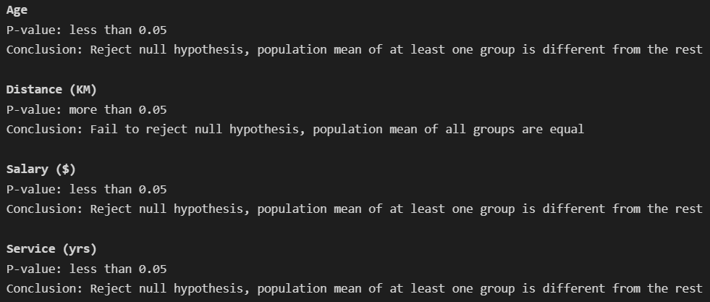
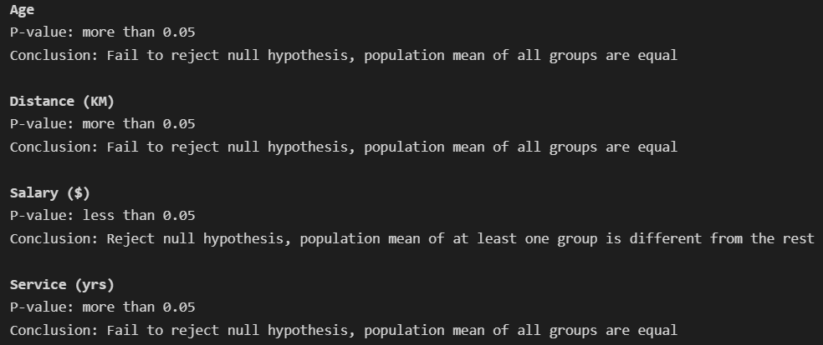
Education
ANOVA (Features to keep)
Marital Status
Job Function

Slide 13
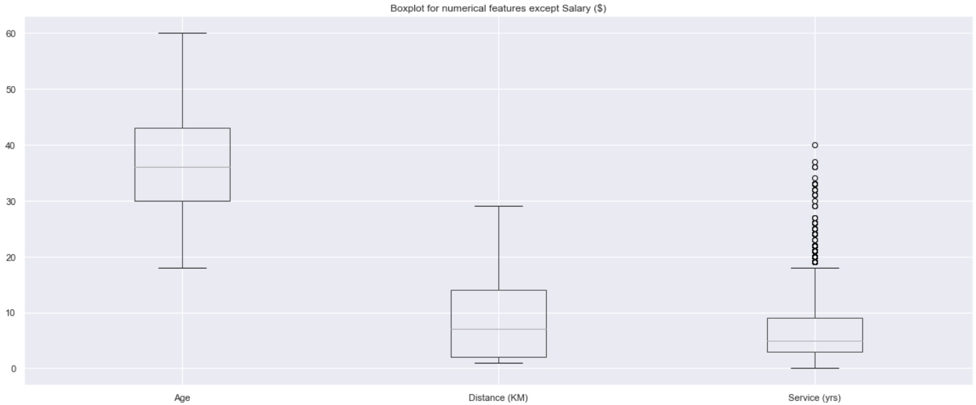
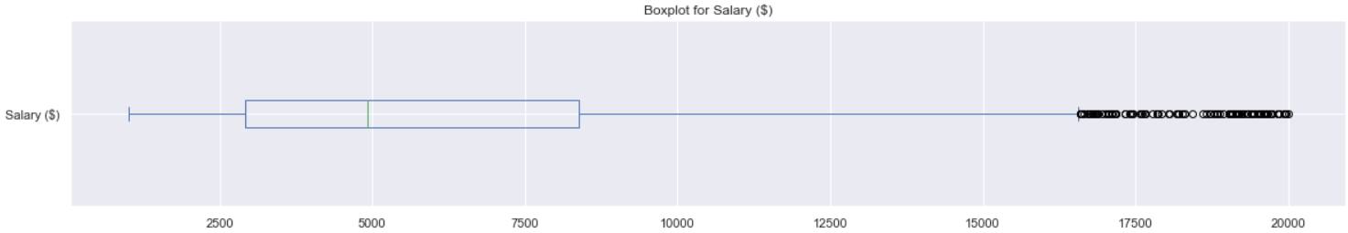
Further preprocessing
Since our numeric features are not on the same scale, we have to scale the numeric features and we will do so by using MinMaxScaler()

Slide 14
Modelling (Overview)
Important things:
How I decide to approach choosing which algorithms to use and how I carried them out
Metrics used to evaluate the model
How I visualized the generated clusters from the respective clustering algorithms
Models will be first tested on their default parameters
Keywords:
K-Prototypes
Spectral Clustering
Agglomerative Clustering
Gower’s Distance
Silhouette score
Factor Analysis of Mixed Data (FAMD)

Slide 15
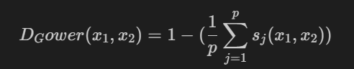
Modelling (Approach)
Two main approaches:
Use of certain clustering algorithms that are meant for numerical features but on Gower’s Distance so as to allow us to fit categorical features too
Use of K-Prototypes algorithm to handle both categorical and numerical features
So, what is Gower’s Distance?
Calculated as the mean of partial dissimilarities across individual data points
It can be used to calculate how different two records are and Gower’s Distance accepts both categorical and numerical data
We can only apply Gower’s Distance clustering algorithms that can take in distance matrices which means we can only use Spectral Clustering, Agglomerative Clustering and DBSCAN/OPTICS.
Another thing to take note of is that data passed into the gower_matrix() function need not be scaled as scaling is already part of the process included in the function

Slide 16
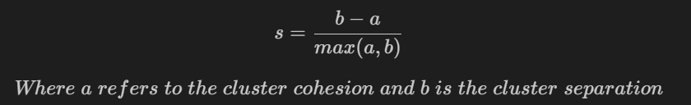
Modelling (Metrics)
Silhouette coefficient:
The range of this scoring metric is from -1 to 1.
-1 means that the clusters are assigned the wrong way
0 means that the clusters are indifferent
1 means that the clusters are clearly distinguished
Therefore, the ideal score is positive and should be near 1

Slide 17
Modelling (Visualization)
We will be using Factor Analysis of Mixed Data (FAMD) to aid us in visualizing the clusters.
What is FAMD?
It is a dimension reduction technique that allows us to visualize the clusters in a lower dimension
It is not a feature selection technique, instead it utilises feature selection methods to extract the most important features for factor analysis
It handles mixed data which is why I chose to use it as conventional methods like PCA can only handle numerical data
Similar to Gower’s Distance, data fitted to FAMD need not be scaled as it is part of the process included in the class already

Slide 18
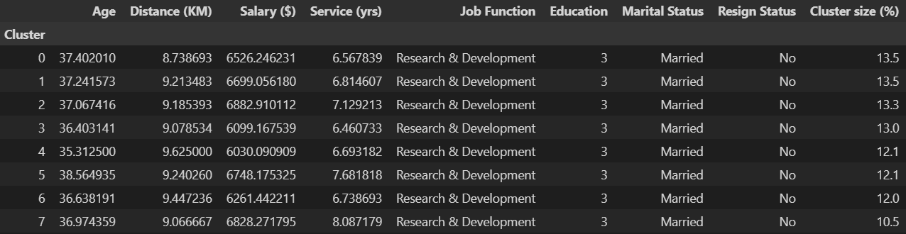
Spectral Clustering
The clusters formed appear to be extremely similar to one another
Resign status for every cluster indicates that all clusters represent employees who are still with the company
Does not give us any insightful knowledge to know which group of employees are the most vulnerable to resignation
Overall, does a terrible job at clustering the data

Slide 19
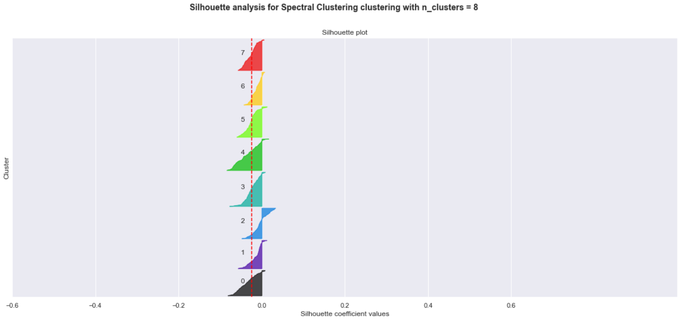
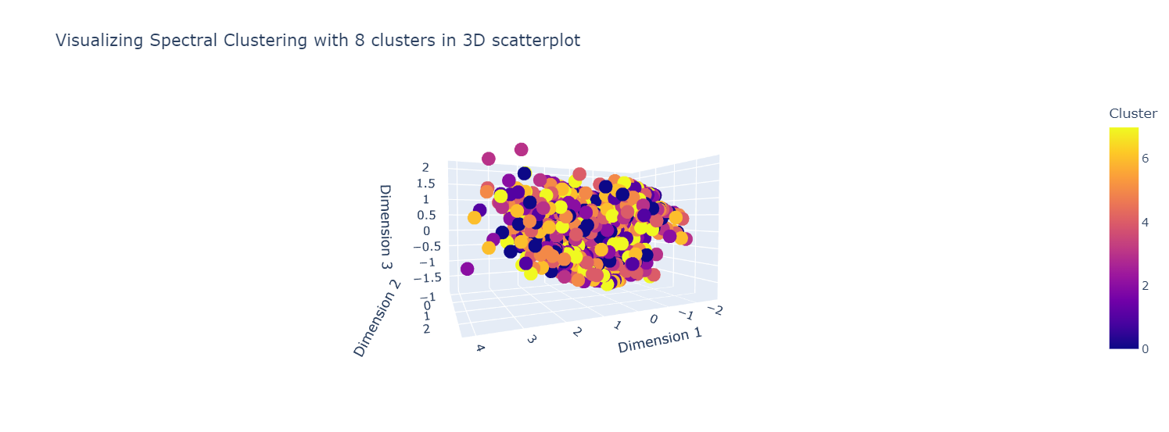
Spectral Clustering
Average silhouette score is negative and close to zero
Indicates clusters are indifferent and the distance between clusters are insignificant
3D scatterplot shows clusters are overlapping with one another
Almost impossible to see any clusters formed
Data points appear to be randomly scattered

Slide 20
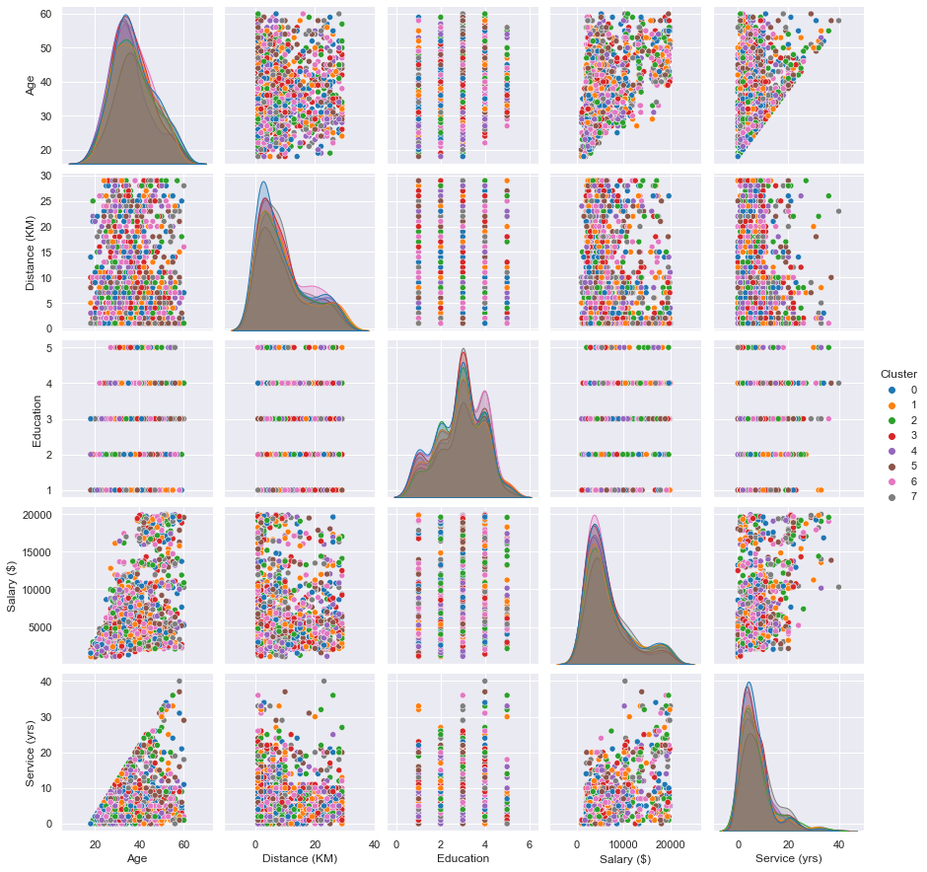
Spectral Clustering
We can also see from the distribution of data that each cluster generally has the same shape, which means the clusters have no difference

Slide 21
Agglomerative Clustering
Cluster sizes is extremely imbalanced as compared to Spectral Clustering
The clusters generated could be essentially just grouping by ‘Resign Status’
Overall, using agglomerative clustering on its default parameters is not ideal at all
This can be easily fixed later when choosing the optimal number of clusters later during model improvement

Slide 22
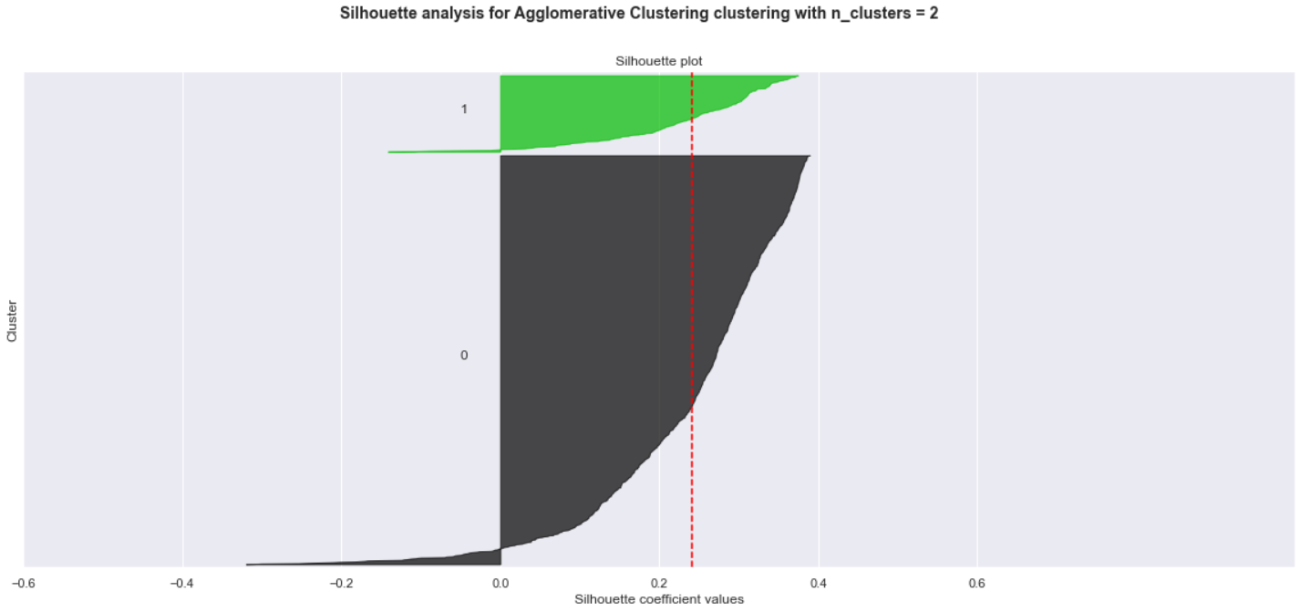
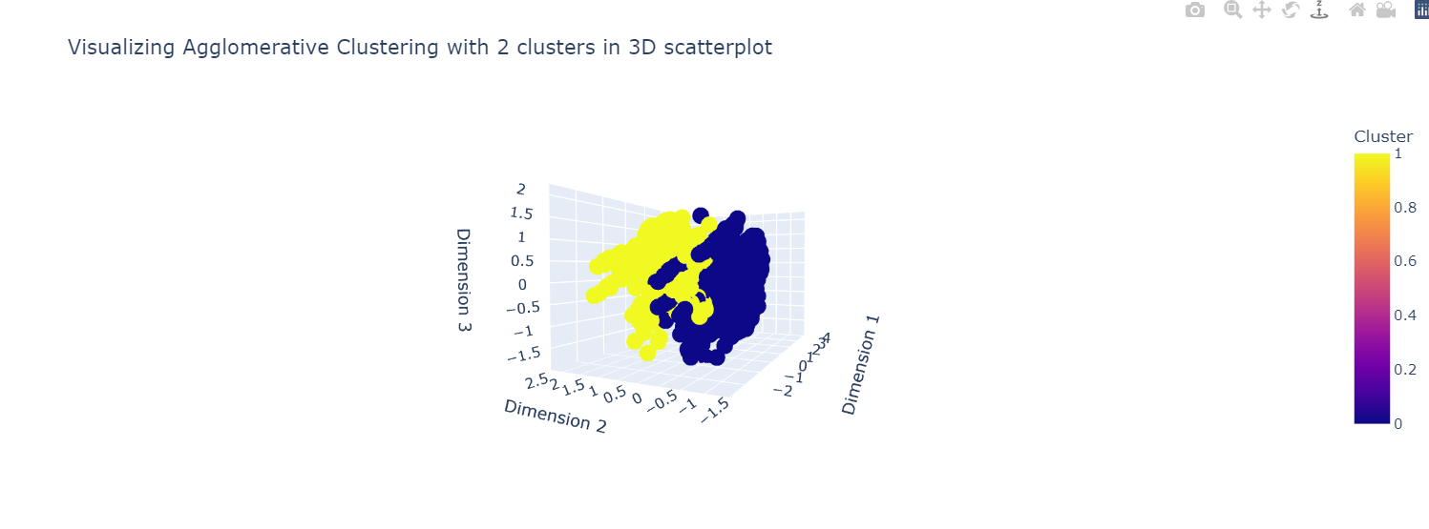
Agglomerative
Silhouette plot shows that the average silhouette score is around 0.25
Both clusters have some data points with negative silhouette scores, indicating that they are wrongly clustered
3D scatterplot shows clusters are distinct and can be easily interpreted unlike the scatterplot in Spectral Clustering

Slide 23
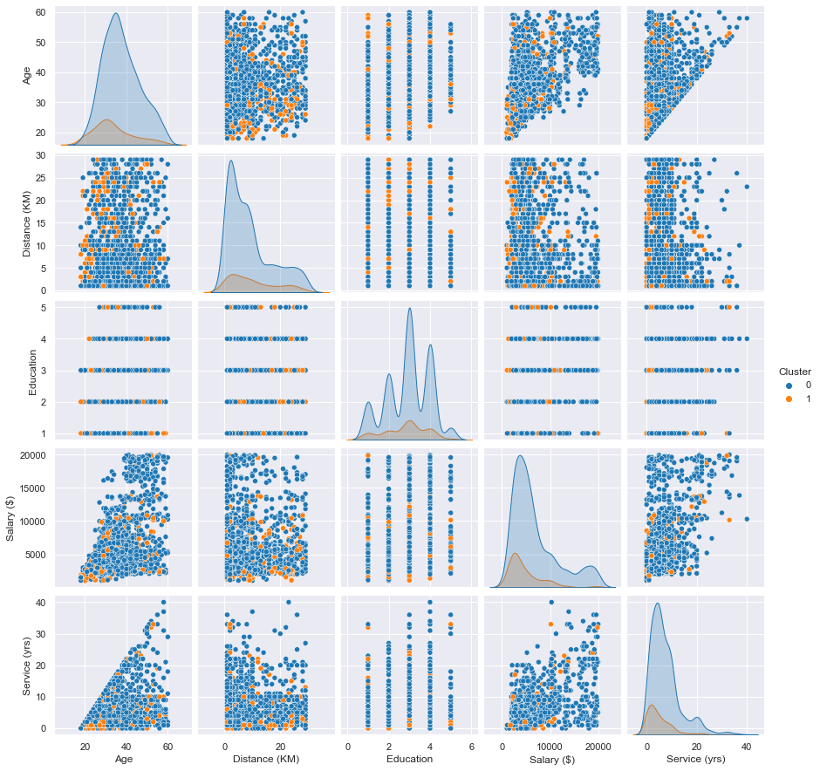
Agglomerative Clustering
Scatterplot shows clearly two distinct clusters that can be easily seen unlike `Spectral Clustering` but this could be also because there are only 2 clusters
We see that generally for the 1st cluster, employees are younger, stay closer to the company, have a lower level of education, lower salary and have stayed in the company for less years

Slide 24
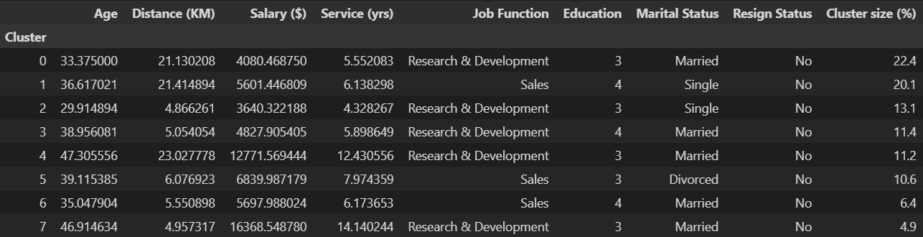
K-Prototypes
Clusters have a lot of variation in characteristics
Evenly-sized clusters
However, resign status indicates that all employees from all clusters are still with the company
Decent clustering groups on the default parameters
Could be influenced by some noise that can be addressed later in feature selection

Slide 25
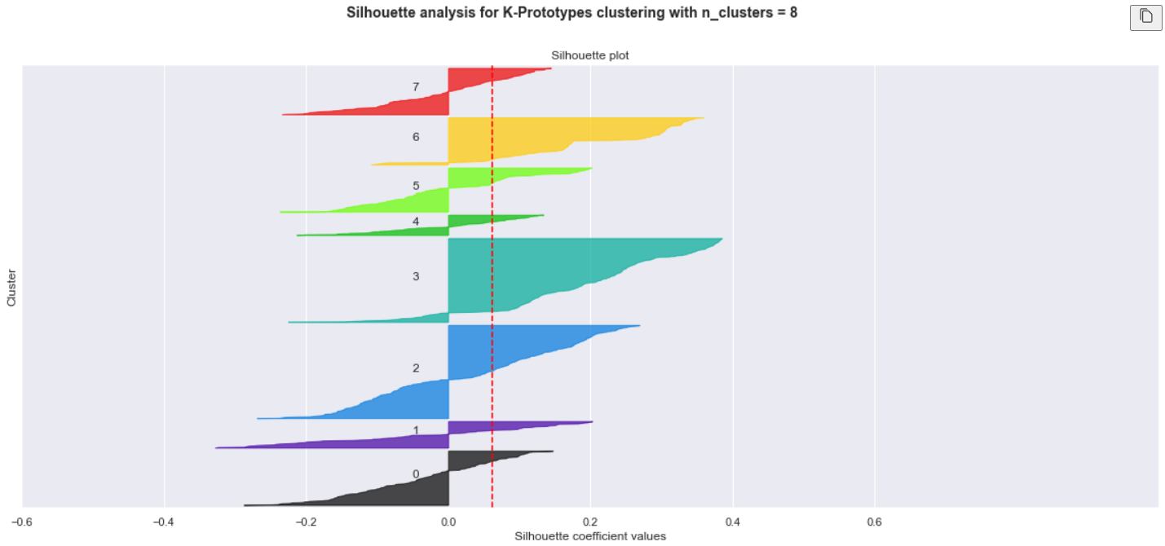
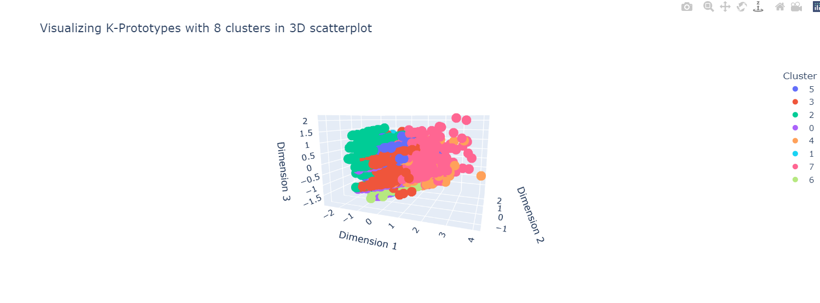
K-Prototypes
Average silhouette score is close to zero
Indicates clusters are indifferent and the distance between clusters are insignificant
For almost every cluster, more than half of the data points have negative silhouette scores indicating that clusters have been assigned wrongly
3D scatterplot shows a slight separation of clusters with a few overlapping clusters

Slide 26
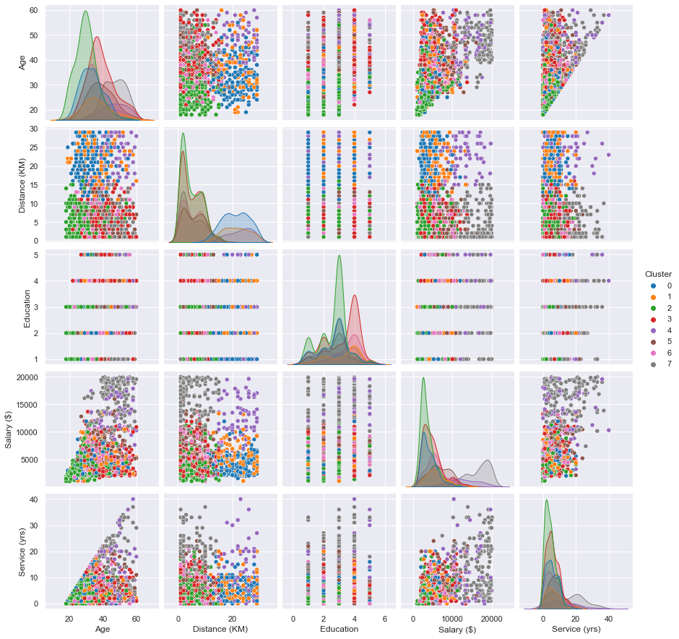
K-Prototypes
We can see a slight separation in clusters from the 3D scatterplot with some overlapping of clusters

Slide 27
Model Assesment
 | Even cluster size | Variation in clusters | Distinguished clusters | Decent silhouette score
Spectral Clustering
Agglomerative Clustering
K-Prototypes Clustering
Overall, we see that Spectral Clustering does not give us a good visualization of clusters and in addition, the centroids of each cluster are extremely similar. Hence, I will omit Spectral Clustering from the model improvement process.

Slide 28
Model Improvement
Elbow plot
Feature Selection
Dendrogram
For the model improvement of K-Prototypes, we can infuse the elbow plot method and feature selection method
We want to look for the best combinations of features that returns the least Clustering Costs
Then, from the best combination of features, select the optimal number of clusters where the ‘elbow’ is at
As for Agglomerative Clustering (Hierarchical), we would determine the optimal number of clusters by drawing a horizontal line at the point where there is the largest vertical distance where the line will not meet any separation of clusters
The number of vertical lines that pass through the horizontal line is the optimal number of clusters
Determing the optimal number of clusters for K-Prototypes
Select the most important features and remove the noise
Determining the optimal number of clusters for Agglomerative Clustering

Slide 29
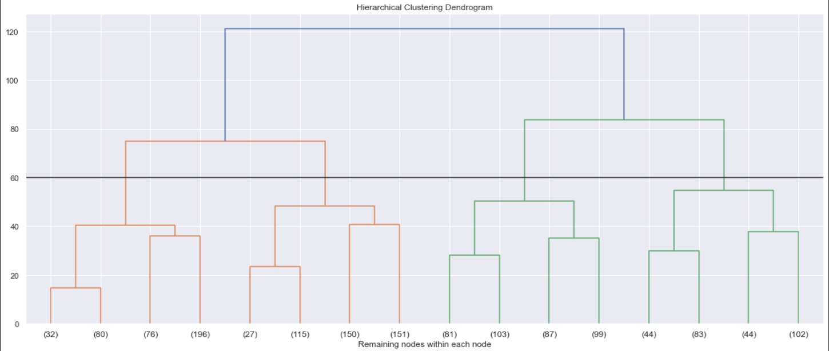
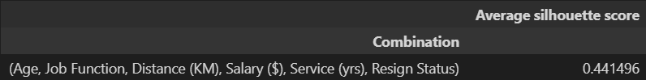
Agglomerative Clustering
From the dendrogram, we see that the horizontal line should be drawn around 60
4 vertical line passes through the horizontal line which means that the optimal number of clusters is 4
From the feature selection, I chose to keep the best combinations of 6 features from the current 8
The best combinations are Age, Job Function, Distance (KM), Salary ($), Service (yrs) and Resign Status
We will now use the improved model to cluster our data

Slide 30
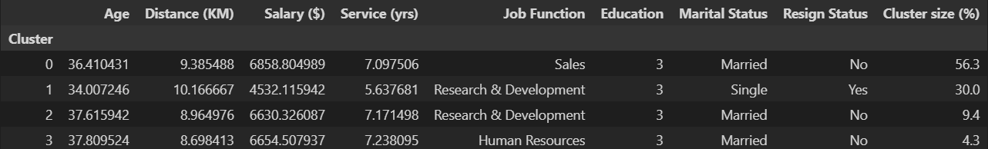
Agglomerative Clustering (Improved)
Using the optimal number of clusters and best combination of features, we were able to get a decent variation of characteristics for each cluster
However, one downside is still that the cluster sizes are not very even with the 0th cluster dominating as it represents 56.3% of the total data
On top of that, there is also a cluster with ‘Yes’ under the Resign Status feature which allows us to know the characteristics of employees who have resigned
Overall, it is an improvement from using the default parameters of the Agglomerative Clustering algorithm

Slide 31
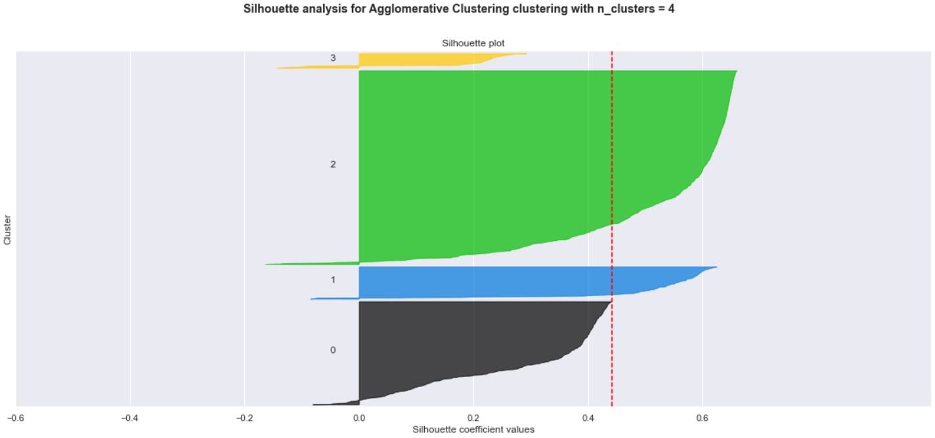
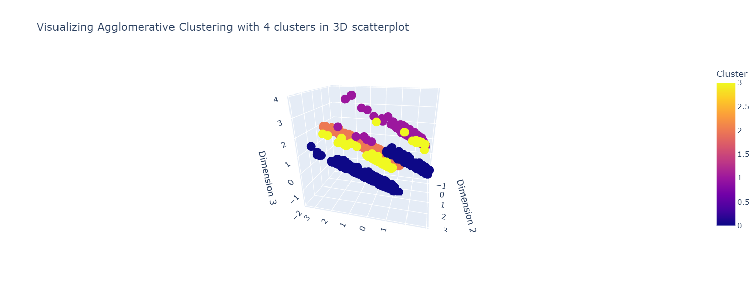
Agglomerative
Average silhouette score is about 0.45
Very little data points from each cluster have negative silhouette score which indicates that clusters are moderately well distinguished
The 3D scatterplot shows the clusters can be clearly seen with no overlapping clusters

Slide 32
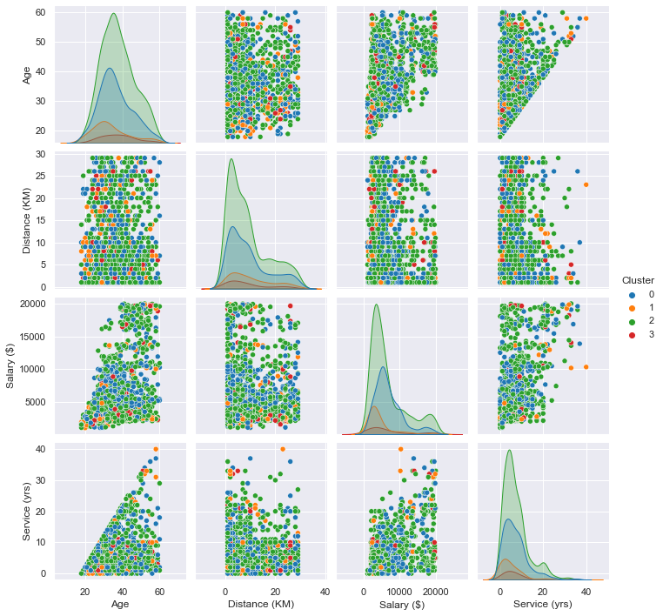
Agglomerative Clustering
From the pairplot we can see the distribution of numeric values are very distinct from one another which means the clusters are defined clearly
The scatter plots do not show a clear separation of clusters between the numeric features included

Slide 33
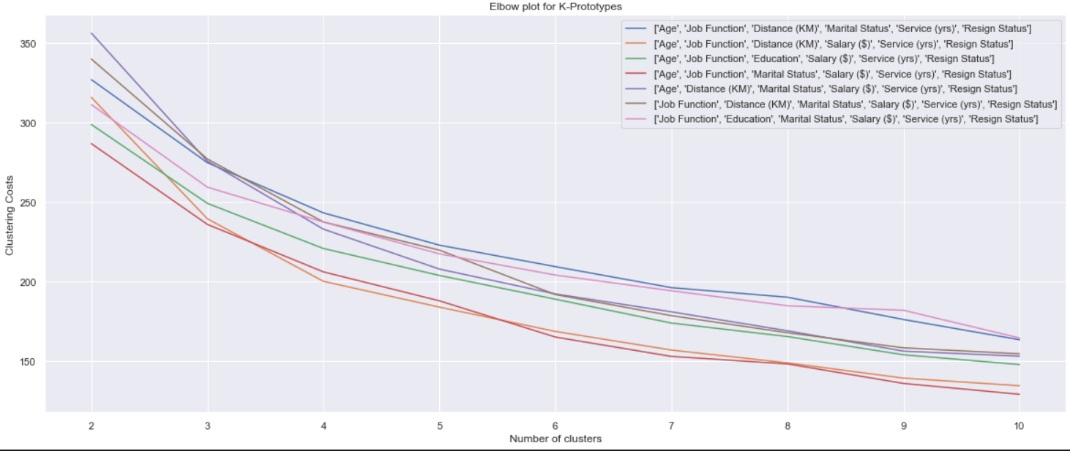
K-Prototypes Clustering
We will short list 2 combinations to test for K-Prototypes
Similarly, we will select 6 our of 8 features for the feature selection
The best combinations of 6 features at 4 clusters is Age, Job Function, Distance (KM), Salary ($), Service (yrs) and Resign Status
For 6 clusters, the best combination is Age, Job Function, Marital Status, Salary ($), Service (yrs) and Resign Status

Slide 34
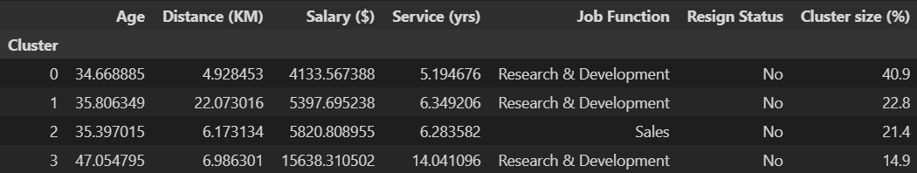
K-Prototypes (4 clusters)
We can see that there is also a good variation of characteristics of the clusters but the 0th cluster is dominating the cluster size with 40.9%
However, all the clusters show that the resign status is 'No' which means that none of the clusters are vulnerable to resignation, which is not what we want to find
Overall, K-Prototypes with 4 clusters and selected features perform not bad but not ideal or as well as Agglomerative Clustering with 4 clusters and selected features

Slide 35
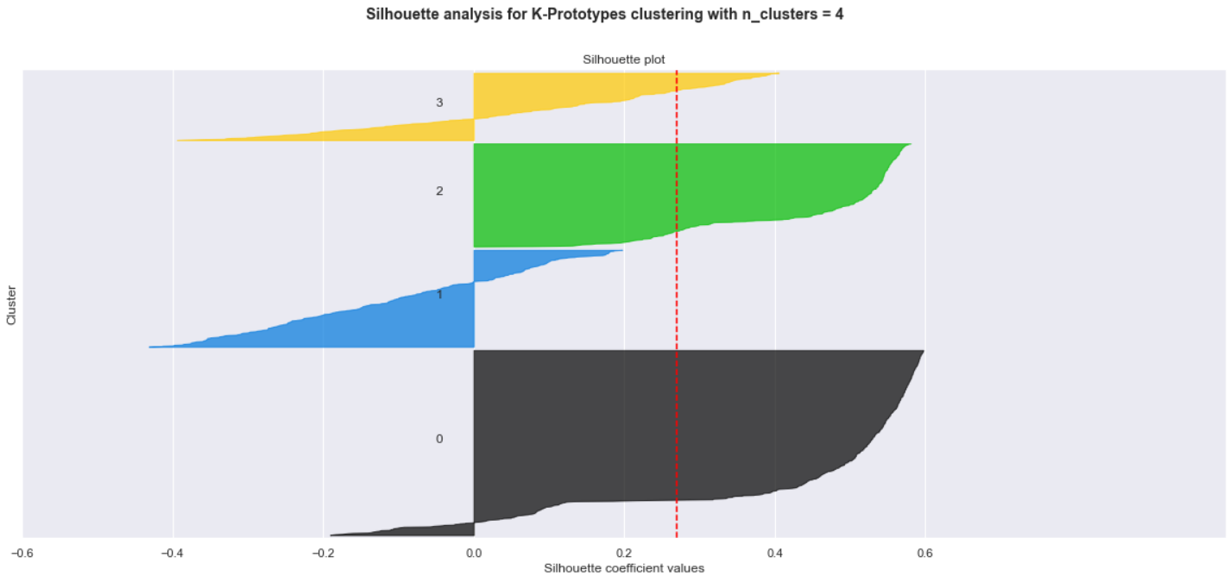
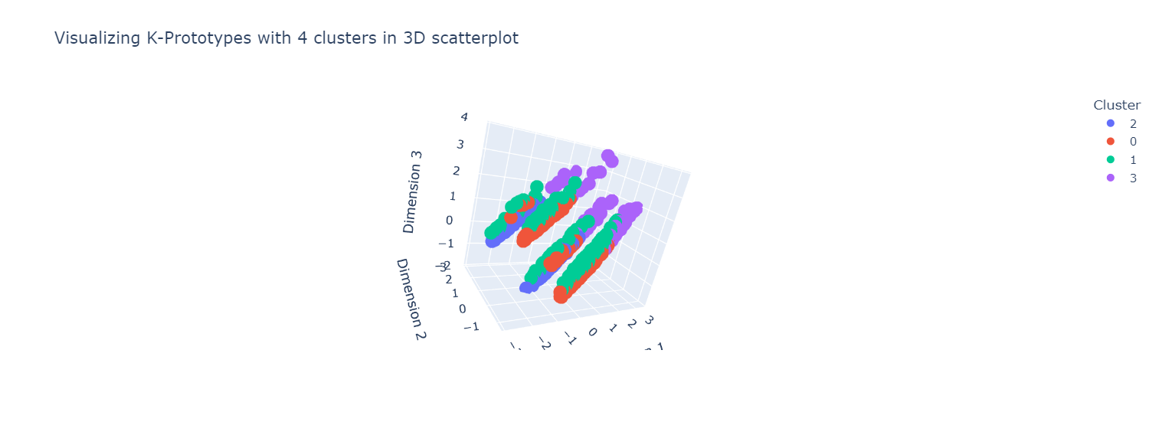
K-Prototypes
Average silhouette coefficient is around 0.3
The 0th and 1st cluster have little data points that have negative silhouette scores but for the 1st and 3rd clusters, there is a significant amount of data points that might be wrongly clustered
The 3D scatter plot shows that there are some overlapping in the clusters especially for the 3rd cluster

Slide 36
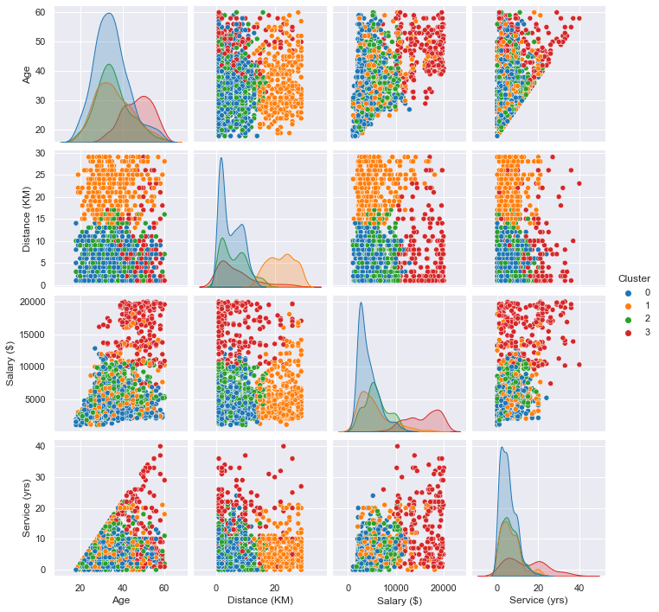
K-Prototypes
We see that for Age, Salary ($) and Service (yrs), the 1st and 2nd clusters seem to have a same distribution which explains in the scatterplot why the data points were clustered together
This means that the 1st and 2nd clusters are not very different from each other

Slide 37
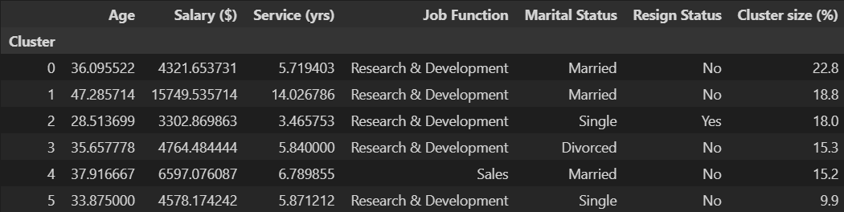
K-Prototypes (6 clusters)
We can see that the characteristics of each cluster are very well-defined in terms of having different characteristics for each cluster
Furthermore, the cluster sizes are very well distributed
We also managed to get a 'Yes' cluster for resign status even though the data was extremely imbalanced favouring 'No'
Now, we are able to single out the group of employees who are still with their companies and we can analyse the clusters where resign status is 'Yes', indicating that they are no longer with the company
It is also a very big improvement from using `K-Prototypes` on default parameters
Overall, `K-Prototypes` with 6 clusters and selected features gives us significant and insightful clusters

Slide 38
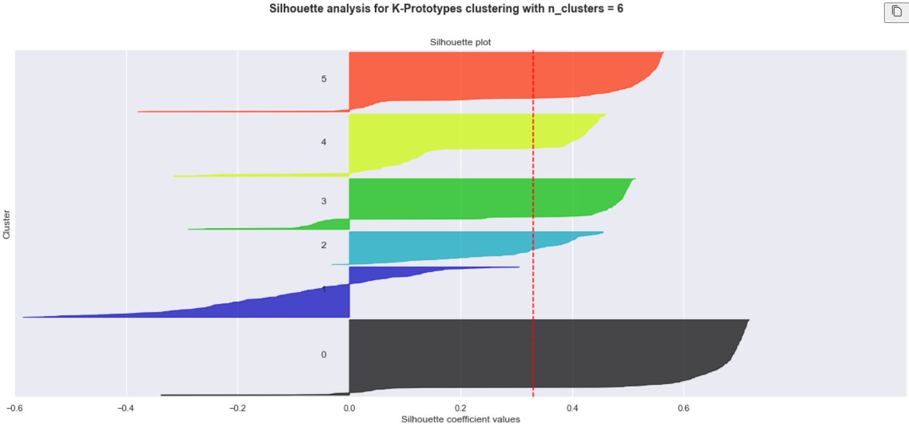
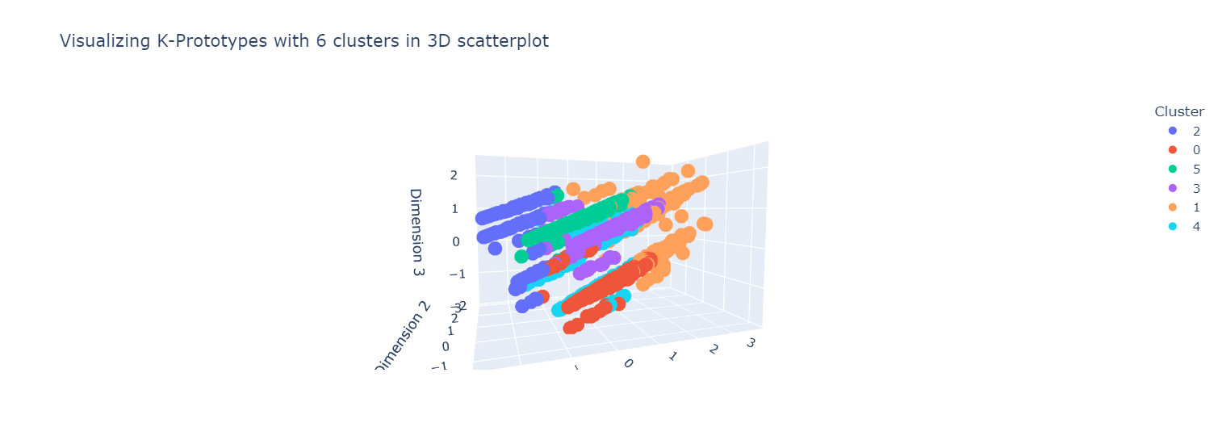
K-Prototypes
Average silhouette score is around 0.35
All of the clusters except the 1st cluster have close to no data points where the silhouette score is negative indicating that the data is generally well clustered and clusters are significant
More than half of the data points in the 1st cluster have negative silhouette scores which means that the data points of that cluster could be assigned the wrong way
The 3D scatterplot shows that some parts of the 1st, 4th and 5th cluster are overlapping in three dimensions

Slide 39
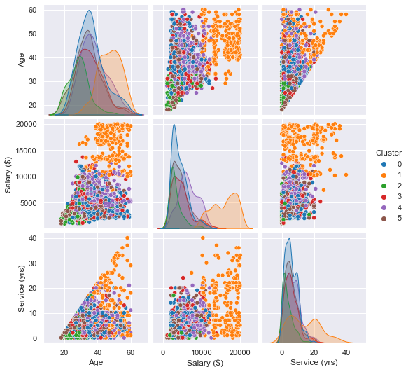
K-Prototypes
Pairplot shows that the distribution for the numerical features are different for all the clusters which is good which means that the clusters are different

Slide 40
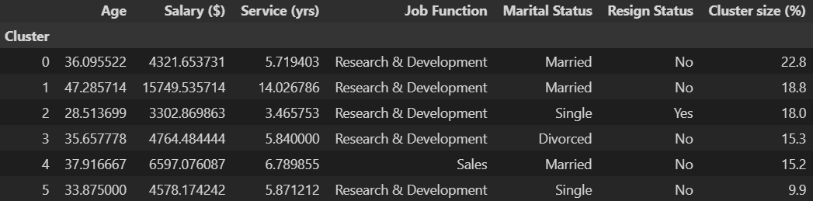
Final Model
I have chosen the final model to be K-Prototypes with 6 clusters.
The features include Age, Job Function, Marital Status, Salary ($), Service (yrs) and Resign Status.
The reason as to why I chose K-Prototypes over Agglomerative Clustering is because K-Prototypes returned slightly more distinct clusters and also because for Agglomerative Clustering, the sizes of each cluster were unequal.

Slide 41
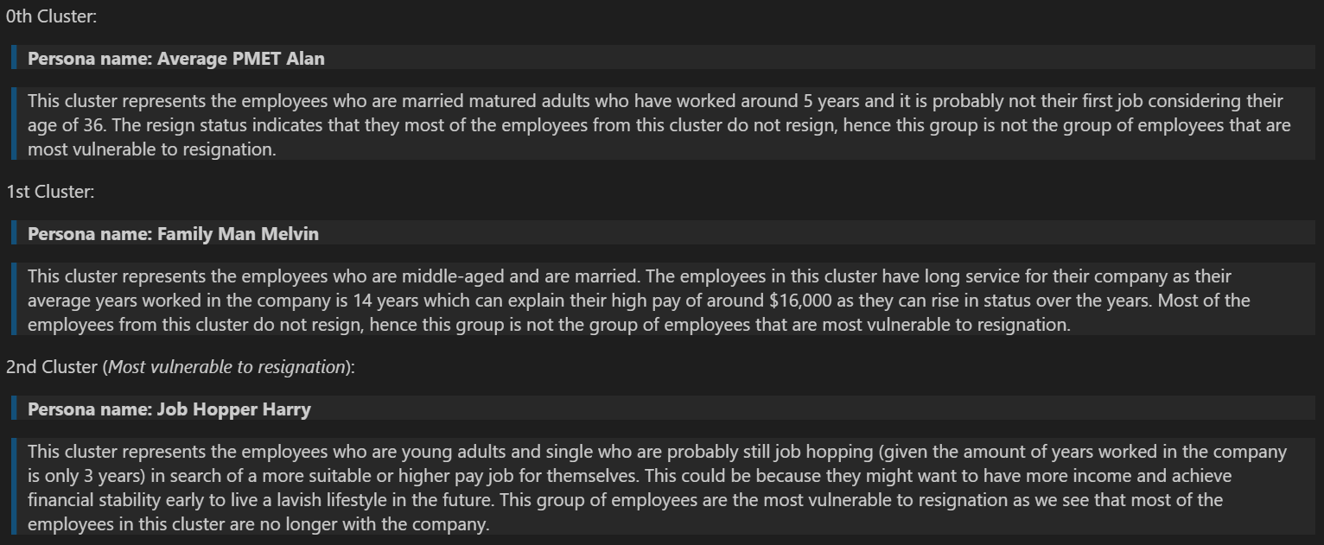
Cluster Analysis

Slide 42

Cluster Analysis

Slide 43
Group of employees most vulnerable to resignation
2nd Cluster:
So, how can companies make an effort to retain these employees?
Counter-offer the resignation and offer the employee better job prospects such as pay increment
Offer employee job rotation where there is flexibility of changing to a department of interest
Ensure the employee of job security
Assure them at chances of promotion in the near future as long as performance is up to standard since they have already been with the company for a few years

Slide 44
Conclusion
I have managed to establish a specific group of employees who are vulnerable to resignation and also devised a plan for companies to try and retain this specific group of employees through clustering.
I am very delighted to have gone through this subset of machine learning as I was able to learn about interesting and special clustering algorithms such as K-Prototypes that is specific for mixed data.
I hope to have more experiences with clustering to explore more of this wonderful sub-domain of machine learning.

Slide 45
Thanks!
This marks the end of my machine learning journey for the module ST1511.
Attribution for slides template and included images:

